Slide 1
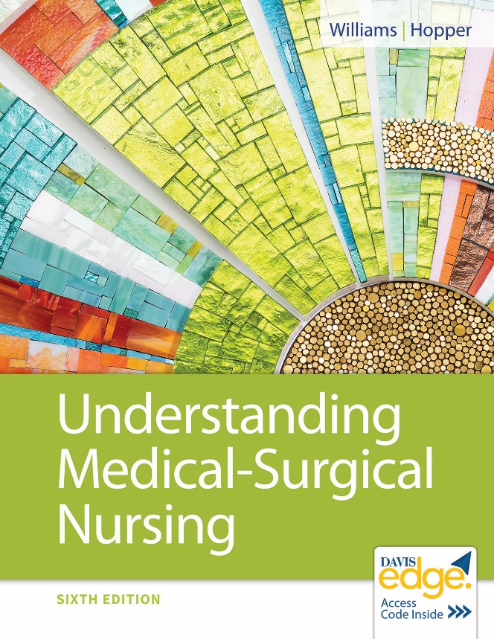
Chapter 28
Nursing Care of Patients With Hematological and Lymphatic Disorders

Slide 2
Learning Outcomes
Explain the pathophysiology of each of the hematological and lymphatic disorders discussed in this chapter.
Describe the etiologies, signs, and symptoms of each disorder.
Identify tests used to diagnose each of the disorders.
Describe current therapeutic measures for each disorder.

Slide 3
Learning Outcomes (continued_1)
List data you should collect when caring for patients with disorders of the hematological or lymphatic systems.
Plan nursing care for patients with hematological disorders.
Plan nursing care for patients with lymphatic disorders.
Explain how you will know if your nursing interventions have been effective.

Slide 4
Learning Outcomes (continued_2)
Describe precautions you should institute to prevent bleeding in patients with clotting disorders.
Identify nursing care and teaching you will provide for patients undergoing a splenectomy.

Slide 5
Anemia
Deficiency of red blood cells (R B C’s), hemoglobin, or both
Impaired production
Increased destruction
Blood loss
Reduced capacity to carry oxygen to tissues

Slide 6
Anemia (continued_1)
Etiologies
Dietary deficiencies
Hemolysis
Hereditary disorders

Slide 7
Anemia (continued_2)
Signs and symptoms
Pallor
Tachycardia
Tachypnea
Irritability
Fatigue
Dyspnea
Pernicious anemia
Numb hands or feet
Sore tongue
Iron deficiency
Mouth fissures
Glossitis
Spoon-shaped nails

Slide 8
Anemia (continued_3)
Diagnostic tests
Complete blood count (C B C) with microscopic examination
Bone marrow analysis
Tests to determine source of bleeding

Slide 9
Anemia (continued_4)
Therapeutic interventions
Eliminate cause
Dietary changes
Supplements
Transfusions

Slide 10
Anemia (continued_5)
Nursing diagnoses
Activity Intolerance
Imbalanced Nutrition
Impaired Oral Mucous Membrane Integrity

Slide 11
Aplastic Anemia
Bone marrow does not produce adequate R B C’s
Causes
Congenital
Exposure to toxins
Chemotherapy

Slide 12
Aplastic Anemia (continued_1)
Signs and symptoms
Weakness
Fatigue
Pallor
Dyspnea
Headache
Ecchymoses
Petechiae
Frank bleeding
Infection
Death

Slide 13
Aplastic Anemia (continued_2)
Diagnostic tests
C B C
Bone marrow biopsy
Total iron-binding capacity (T I B C)
Serum iron
Treatment
Treat cause
Colony-stimulating factors
Steroids
Bone marrow transplant

Slide 14
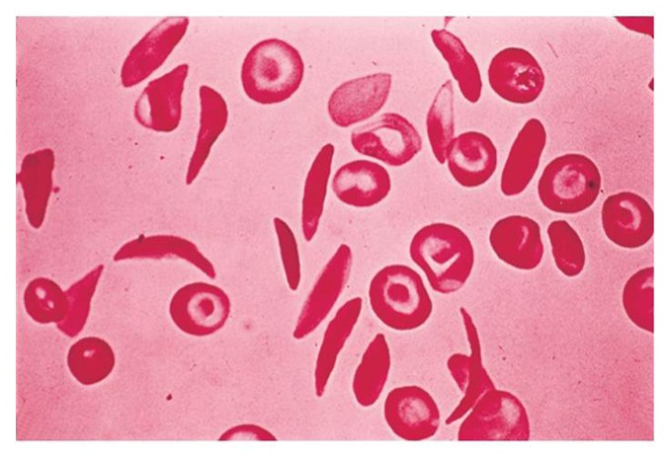
Sickle Cell Anemia
Inherited autosomal recessive disorder

Slide 15
Sickle Cell Anemia (continued_1)
Diagnostic tests
Sickledex test
Hemoglobin electrophoresis
C B C
Erythrocyte sedimentation rate (E S R)
Crisis treatment
Antibiotics
Pain management
Transfusions
Fluids
Oxygen

Slide 16
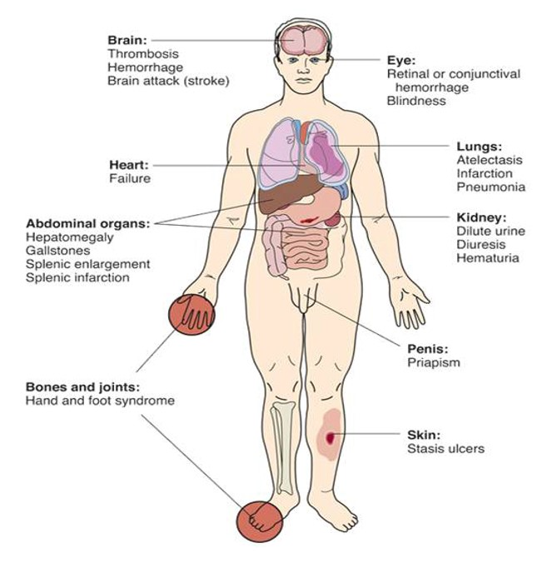
Sickle Cell Anemia (continued_2)
Signs and symptoms
Notes:
Clinical manifestations of sickle cell anemia.

Slide 17
Sickle Cell Anemia (continued_3)
Crisis prevention
Avoid risk of reduced oxygenation.
Exposure to cold
Infection
Strenuous exercise
Low-dose penicillin
Frequent transfusions
Hydroxyurea

Slide 18
Sickle Cell Anemia (continued_4)
Nursing diagnoses
Risk for Ineffective Tissue Perfusion
Acute Pain

Slide 19
Sickle Cell Anemia (continued_5)
Patient education
Avoid
Tight clothing
Strenuous exercise
Alcoholic beverages
Cold temperatures
Smoking
Unpressurized aircraft
Exposure to infection

Slide 20
Polycythemia
Overabundance of R B C’s
Hemoglobin >18 milligrams per deciliter
Hematocrit >55%
Blood becomes thick
Primary
Secondary

Slide 21
Polycythemia (continued_1)
Signs and symptoms
Hypertension
Visual changes
Headache
Vertigo
Dizziness
Tinnitus
Bleeding
Chest pain
Dyspnea
Dark, flushed skin
Itching

Slide 22
Polycythemia (continued_2)
Therapeutic interventions
Phlebotomy
Low-dose aspirin
Chemotherapy
Radiation therapy

Slide 23
Polycythemia (continued_3)
Patient education
Drink 3 liters of water daily.
Avoid restrictive clothing.
Elevate feet.
Report signs and symptoms of iron deficiency.
Report signs and symptoms of bleeding.

Slide 24
Disseminated Intravascular Coagulation
Pathophysiology
Accelerated clotting
Clotting factors depleted
Bleeding
Etiology
Major trauma

Slide 25
Disseminated Intravascular Coagulation (continued_1)
Signs and symptoms
Abnormal bleeding
Joint pain
Nausea and vomiting
Organ system failure
Convulsions
Shock, coma
Death

Slide 26
Disseminated Intravascular Coagulation (continued_2)
Bleeding signs and symptoms
Easy bruising
Petechiae
Blood in urine
Black, tarry stools
Bleeding from nose or gums
New onset of painful joints

Slide 27
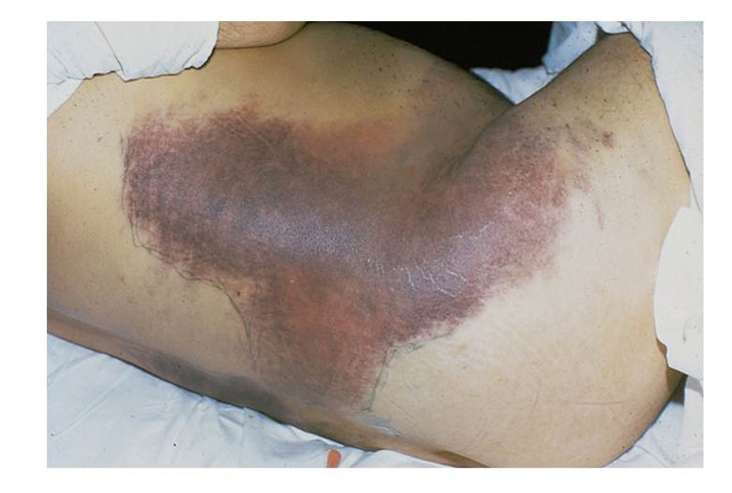
Ecchymoses

Slide 28
Disseminated Intravascular Coagulation (continued_3)
Diagnostic tests
Prothrombin time (P T) and partial thromboplastin time (P T T)
Platelet count
Hemoglobin, creatinine

Slide 29
Disseminated Intravascular Coagulation (continued_4)
Therapeutic interventions
Correct underlying cause
Administer
Blood
Fresh frozen plasma
Platelets
Cryoprecipitates

Slide 30
Disseminated Intravascular Coagulation (continued_5)
Nursing care
Recognize and report bleeding.
Avoid trauma and further bleeding.
Teach patient and family.

Slide 31
Idiopathic Thrombocytopenic Purpura
Pathophysiology
Platelet destruction by immune system
Risk for bleeding
Etiology
Acute viral illness
Drug reaction
Immune system dysfunction

Slide 32
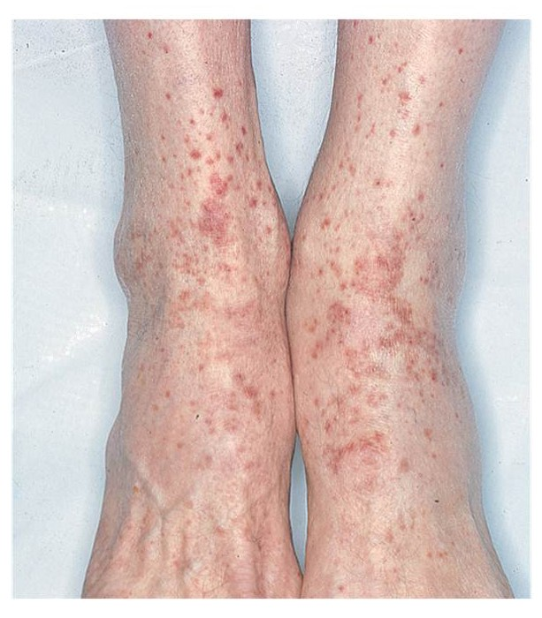
Idiopathic Thrombocytopenic Purpura (continued_1)
Signs and symptoms
Bleeding
Petechiae (see photo)
Ecchymoses (see slide 27)
Bleeding

Slide 33
Idiopathic Thrombocytopenic Purpura (continued_2)
Diagnostic tests
Platelet count
Bleeding time
Bone marrow aspiration

Slide 34
Idiopathic Thrombocytopenic Purpura (continued_3)
Therapeutic interventions
Steroids
Chemotherapy
Transfusions
Vitamin K
Splenectomy

Slide 35
Idiopathic Thrombocytopenic Purpura (continued_4)
Nursing care
Take bleeding precautions.
Recognize and report signs and symptoms bleeding.
Teach patient and family.

Slide 36
Bleeding Precautions
Use electric razor.
Use soft toothbrush.
Avoid invasive procedures, injections.
Maintain pressure if blood draw essential.
Wear shoes or slippers.
Avoid bumps and bruises.
Avoid aspirin and N S A I D’s.
Administer stool softener.
Handle patient gently.
Gentle nose blowing.

Slide 37
Hemophilia
Pathophysiology
Missing clotting factors
A: Factor Eight
B: Factor Nine
Etiology
Heredity

Slide 38
Hemophilia (continued_1)
Signs and symptoms
Bleeding
Joints
Muscles
Subcutaneous tissue
Brain

Slide 39
Hemophilia (continued_2)
Diagnostic tests
P T T
Factor levels

Slide 40
Hemophilia (continued_3)
Therapeutic interventions
Desmopressin
Clotting factors
Factor Eight
Factor Nine
Blood transfusion

Slide 41
Hemophilia (continued_4)
Nursing diagnoses
Acute Pain
Risk for Bleeding

Slide 42
Leukemia
Pathophysiology
Increase in immature white blood cells (W B C’s)
Unable to fight infection
Risk factors
Viruses
Genetic factors
Radiation/chemotherapy

Slide 43
Leukemia (continued_1)
Types
Acute lymphocytic leukemia (A L L)
Acute myelogenous (myeloblastic) leukemia (A M L)
Chronic lymphocytic leukemia (C L L)
Chronic myelogenous leukemia (C M L)

Slide 44
Leukemia (continued_2)
Signs and symptoms
Fever
Infection
Pallor
Weakness
Tachycardia
Palpitations
Dyspnea
Abdominal pain
Malaise
Sternal/rib pain
Central nervous system changes
Bleeding

Slide 45
Leukemia (continued_3)
Diagnostic tests
C B C
Bone marrow aspiration
Lumbar puncture
Genetic analysis

Slide 46
Leukemia (continued_4)
Therapeutic interventions
Chemotherapy
Radiation therapy
Bone marrow transplant
Peripheral blood stem cell transplant

Slide 47
Leukemia (continued_5)
Nursing diagnoses
Risk for Injury (Infection, Bleeding)
Fatigue
Impaired Oral Mucous Membrane Integrity

Slide 48
Multiple Myeloma
Pathophysiology
Cancer of plasma cells in bone marrow
Tumors devour bone tissue
Organ invasion
Etiology
Unknown
Occupational exposures

Slide 49
Multiple Myeloma (continued_1)
Signs and symptoms
Bone pain
Fever
Malaise
Spinal cord compression
Pathological fractures
Hypercalcemia
Infection

Slide 50
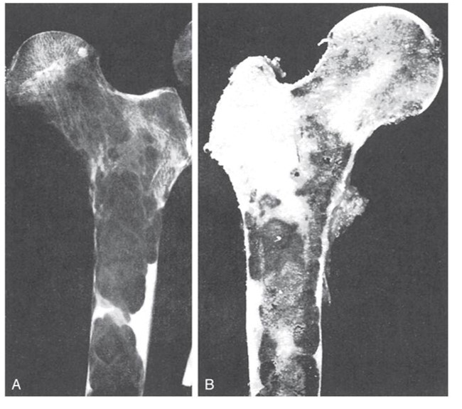
Multiple Myeloma (continued_2)
Diagnostic tests
C B C, blood calcium
Bone x-rays
Urine for Bence-Jones proteins
Bone marrow biopsy

Slide 51
Multiple Myeloma (continued_3)
Therapeutic interventions
Steroids
Chemotherapy
Control of serum calcium
Radiation
Stem cell transplantation
I V pamidronate (Aredia)

Slide 52
Multiple Myeloma (continued_4)
Nursing diagnoses
Risk for Infection
Risk for Injury
Fracture
Complications of immobility
Hypercalcemia

Slide 53
Hodgkin Disease
Cancer of lymph system
Presence of Reed-Sternberg cells
Etiology
Viral
Genetic
Immune dysfunction

Slide 54
Hodgkin Disease (continued_1)
Signs and symptoms
Painless swollen lymph node
Pruritis
Pain induced by alcohol
Fever
Night sweats
Weight loss
Malaise

Slide 55
Hodgkin Disease (continued_2)
Late signs and symptoms
Edema of face and neck
Jaundice
Nerve pain
Retroperitoneal node involvement
Spleen, liver, and bone involvement

Slide 56
Hodgkin Disease (continued_3)
Diagnostic tests
Biopsy
Lymph node
Liver and spleen
Bone marrow
Computed tomography (C T) scan
Chest x-ray
Lung scan
Bone scan
Lymphangiography
C B C
Notes:
Please see figure 28.7, page 541 of the text, cervical Hodgkin disease.

Slide 57
Hodgkin Disease (continued_4)
Staging
Stage One: Single lymph node or site
Stage Two: Two or more nodes on same side of diaphragm
Stage Three: Nodes on both sides of diaphragm
Stage Four: Widely disseminated disease in organs or tissues

Slide 58
Hodgkin Disease (continued_5)
Therapeutic interventions
Chemotherapy
Radiation therapy

Slide 59
Hodgkin Disease (continued_6)
Nursing diagnoses
Activity Intolerance
Risk for Infection

Slide 60
Non-Hodgkin Lymphomas
Lymphoma arising from B cells and T cells
Absence of Reed-Sternberg cells
Etiology
Some viruses
Helicobacter pylori
Immune dysfunction
Occupational exposures

Slide 61
Non-Hodgkin Lymphomas (continued_1)
Signs and symptoms
Painless lymph nodes
Enlarged tonsils and adenoids
Other signs and symptoms similar to Hodgkin disease

Slide 62
Non-Hodgkin Lymphomas (continued_2)
Diagnostic tests
Biopsy
Lymph nodes
Tonsils
Bone marrow
Liver
Other
Bone scan
C T scan
Chest x-ray
I V pyelogram
Magnetic resonance imaging
Positron emission tomography scan
Lymphangiography
C B C
Liver function studies
Serum calcium

Slide 63
Non-Hodgkin Lymphomas (continued_3)
Therapeutic interventions
Chemotherapy
Monoclonal antibodies
Interferon therapy
Radiation therapy
Stem cell transplant

Slide 64
Non-Hodgkin Lymphomas (continued_4)
Nursing diagnoses
Activity Intolerance
Risk for Infection

Slide 65
Comparison of Lymphomas
Hodgkin
Less common
Age 15 to 40 and >55
Reed-Sternberg cells
Younger
Good prognosis
Alcohol-induced pain
Non-Hodgkin
More common
Usually >age 50
Absence of Reed-Sternberg cells
Poorer prognosis

Slide 66
Splenectomy
Surgical removal of the spleen
Preoperative care
Baseline labs
Blood transfusion if necessary
Vitamin K
Baseline vital signs
Teach coughing and deep breathing

Slide 67
Splenectomy (continued_1)
Postoperative care
Monitor for bleeding.
Monitor vital signs.
Administer narcotics for pain.
Encourage to cough and deep breathe and ambulate.

Slide 68
Splenectomy (continued_2)
Complications
Bleeding
Pneumonia
Atelectasis
Infection
Overwhelming postsplenectomy infection

Slide 69
Review Question
The patient with which type of anemia must avoid strenuous exercise and cold temperatures?
Aplastic
Sickle cell
Hemolytic
Anemia of chronic disease

Slide 70
Review Question Answer
Correct Answer: 2

Slide 71
Review Question (continued_1)
Patients with which disorders are at risk for hemorrhage? Select all that apply.
Idiopathic thrombocytopenic purpura
Hemolytic anemia
Disseminated intravascular coagulation
Aplastic anemia
Multiple myeloma

Slide 72
Review Question Answer (continued_1)
Correct Answer: 1, 2, 3, 4, 5

Slide 73
Review Question (continued_2)
The patient with which disorder is most at risk for fractures?
Hodgkin lymphoma
Multiple myeloma
Leukemia
Hemophilia

Slide 74
Review Question Answer (continued_2)
Correct Answer: 2

Slide 75
Review Question (continued_3)
Which assessment is most important for the patient with leukemia?
Heart rate
Skin integrity
Bowel sounds
Temperature

Slide 76
Review Question Answer (continued_3)
Correct Answer: 4

Slide 77
Review Question (continued_4)
Which patient must be instructed about the risk of overwhelming postsplenectomy infection?
Patient receiving chemotherapy
Patient diagnosed with multiple myeloma
Postsplenectomy patient
Patient diagnosed with sickle cell anemia

Slide 78
Review Question Answer (continued_4)
Correct Answer: 3

